Slide 1

Proposal Presentation on Vehicle Auctioning App
By Aashis Maharjan
Date: 2077/11/11

Slide 2
Introduction
Mobile app user for auctioning of used motar vehicle
A C2C app
People can sell and bid used vehicle
Uses a price determination algo
Will provide a web app for moderators

Slide 3
Problem Statement:
No arability of C2C apps
Most platforms use COD
Some people have hard time determining price

Slide 4
Objective:
To Provide a platform for selling and buying vehicle
To provide a user friendly application
To provide a safe payment
To give people the best value for the vehicles
To provide a real time experience

Slide 5
Scope:
Mobile Application available for both android api level 19 ( Android4.1 Kitkat) and ios 7 or higher
For people looking to buy or sell vehicles

Slide 6
Methodology
WaterFall Model
Types of Testing: Unit Testing/Feature Testing and Integration Testing
Backend: nodejs
Mobile App: Dart, Flutter
Web App: Reactjs
DataBase: Mongodb

Slide 7
Feasibility
Technical Feasibility
Can be runned with available hardware
Is scalable
Operational Feasibiliy
Need mod for watching over after deployment
Schedule Feasibility
Project can be completed within the given timeframe

Slide 8
High Level Design

Slide 9
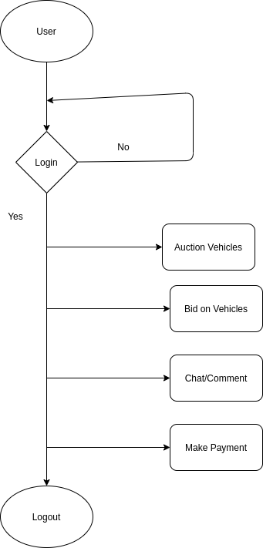
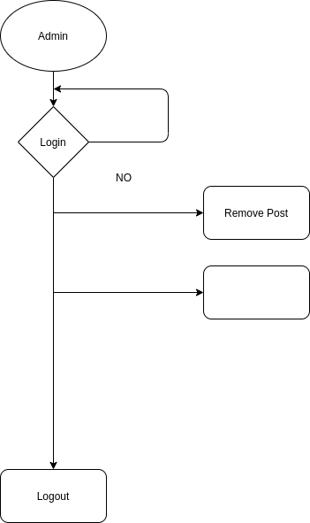

Slide 10
Time Schedule

Slide 11
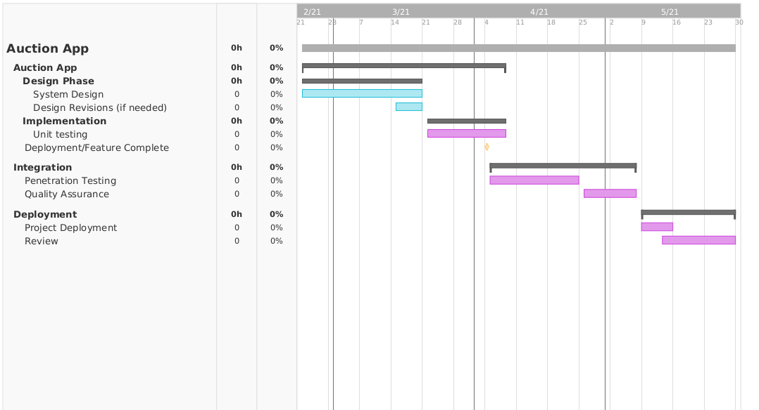

Slide 12
Expected Outcome
A secure platform for buying and selling vehicle
A platform for people who want fair price for their vechcle

Slide 13

Thank You

